Slide 1
Electrical Safety in Construction
29 CFR 1926 Subpart K – Electrical
Notes:
Revised 06/25
The information in this presentation is provided voluntarily by the N.C. Department of Labor, Education Training and Technical Assistance Bureau as a public service and is made available in good faith. This presentation is designed to assist trainers conducting OSHA outreach training for workers. Since workers are the target audience, this presentation emphasizes hazard identification, avoidance, and control – not standards. No attempt has been made to treat the topic exhaustively. It is essential that trainers tailor their presentations to the needs and understanding of their audience.
The information and advice provided on this Site and on Linked Sites is provided solely on the basis that users will be responsible for making their own assessment of the matters discussed herein and are advised to verify all relevant representations, statements, and information.
This presentation is not a substitute for any of the provisions of the Occupational Safety and Health Act of North Carolina or for any standards issued by the N.C. Department of Labor. Mention of trade names, commercial products, or organizations does not imply endorsement by the N.C. Department of Labor.

Slide 2
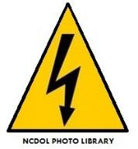
Objectives
At the end of this course, students will be able to:
Identify common electrical hazards
Identify the standards relating to those hazards
Identify electrical equipment defects/hazards
Understand some of the tools/techniques used in identifying hazards

Slide 3
29 CFR 1926 - Subpart K
1926.400 – Introduction
1926.402 – Applicability
1926.403 – General requirements
1926.404 – Wiring design and protection
1926.405 – Wiring methods, components, and equipment
1926.406 – Specific purpose equipment and installations
1926.407 – Hazardous (classified) locations
1926.408 – Special systems
1926.416, 417, 431, 432, 441 – Safety-related practices and maintenance
1926.449 – Definitions

Slide 4
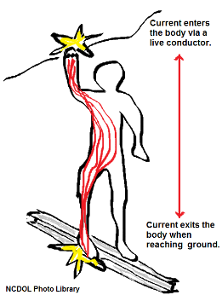
Common Electrical Hazards
Electric shock/electrocution occurs, when current flows through the body damaging the body.
Electrical burns are caused by arc blast or hot conductors.
Indirect falls from ladders, scaffolds or other walking and working surfaces.

Slide 5
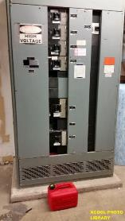
Common Electrical Hazards
Explosions can occur due to electricity (ignition source).
Example:
When the atmosphere contains flammable vapors.
Electrical fires can be caused by
overloading a circuit, appliance,
faulty wiring, etc.

Slide 6
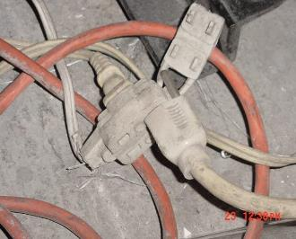
General Requirements 1926.403(b)(1)
Electrical equipment must be free from recognized hazards that can cause death or serious physical harm to employees
Suitability for installation
Mechanical strength and durability
Electrical insulation
Heating effects under condition
of use
Arcing effects
Classification by type, size, voltage, current capacity, specific use
NCDOL Photo Library
NCDOL Photo Library

Slide 7
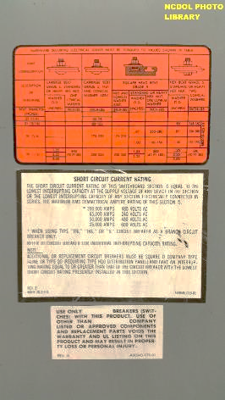
General Requirements 1926.403(b)(2)
Listed, labeled, or certified equipment must be installed and used in accordance with instructions included in the listing, labeling or certification.

Slide 8
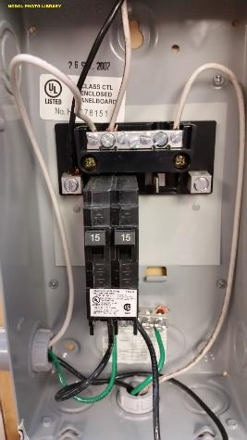
Nationally Recognized Testing Laboratories
Canadian Standards Association (CSA International)
Communication Certification Laboratory, Inc. (CCL)
Curtis-Straus LLC (CSL)
FM Approvals LLC (FM)
Intertek Testing Services NA, Inc. (ITSNA)
MET Laboratories, Inc. (MET)
NSF International (NSF)
National Technical Systems, Inc. (NTS)
SGS U.S. Testing Company, Inc. (SGSUS)
Southwest Research Institute (SWRI)
TUV SUD America, Inc. (TUVAM)
TUV SUD Product Services GmbH (TUVPSG)
TUV Rheinland of North America, Inc. (TUV)
Underwriters laboratory Inc. (UL)
Wyle Laboratories, Inc. (WL)

Slide 9
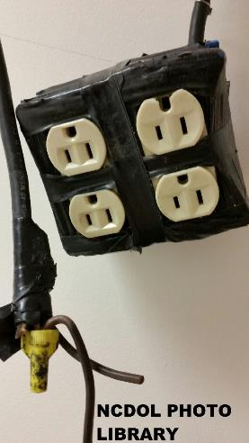
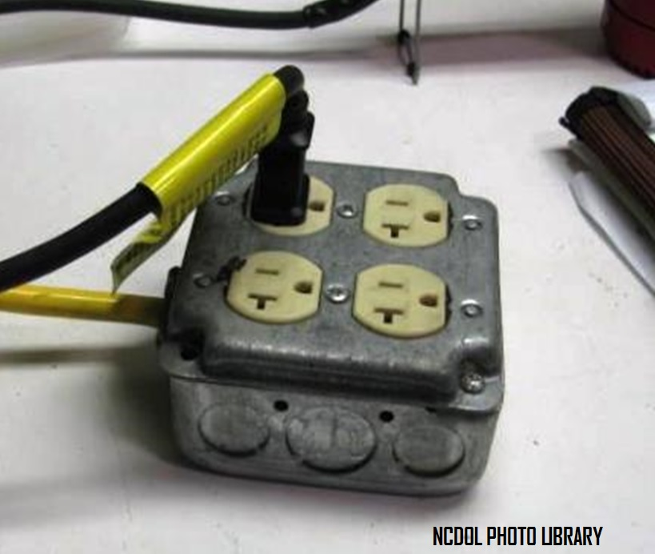
Box Not Approved as a Pendant

Slide 10
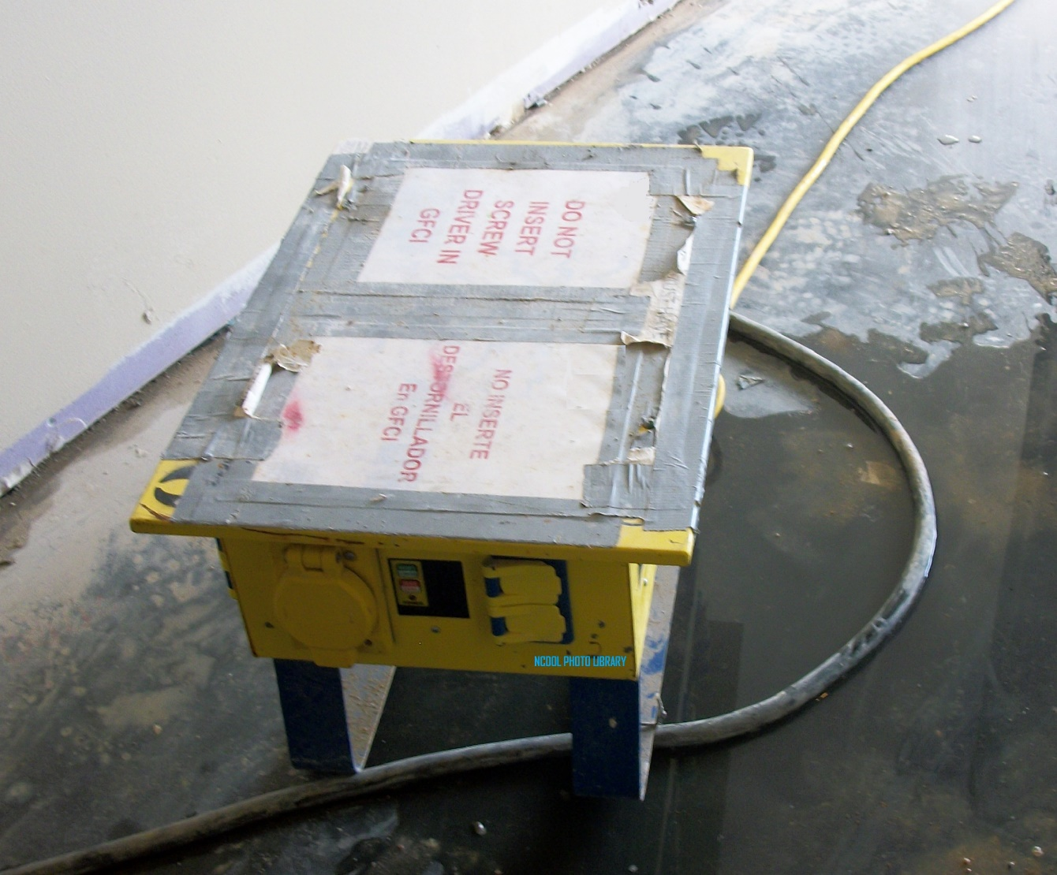
Better Alternative

Slide 11
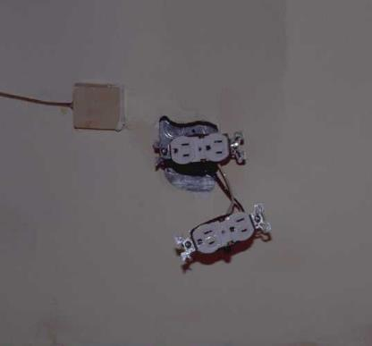
General Requirements 1926.403(b)(2)
Equipment shall be installed and used in accordance with instructions.
NCDOL Photo Library

Slide 12
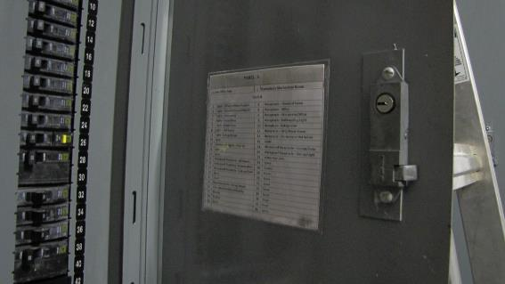
General Requirements 1926.403(h)
Each service, feeder, and branch circuit, at its disconnecting means or over current device, shall be legibly marked to indicate its purpose.
NCDOL Photo Library

Slide 13
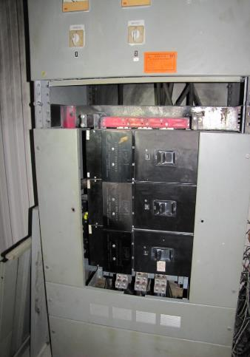
General Requirements 1926.403(i)(2)
Live parts of electric equipment operating at 50 volts or more shall be guarded against accidental contact by cabinets or other forms of enclosures, or by another suitable method.
NCDOL Photo Library

Slide 14
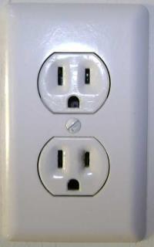
Wiring Design and Protection 1926.404(a)(2)
Correct Polarity
Polarity of connections
No grounded conductor may be attached to any terminal or lead so as to reverse designated polarity.
Neutral
Hot
Ground
Hot
NCDOL Photo Library
Ground
Neutral
Reversed Polarity

Slide 15
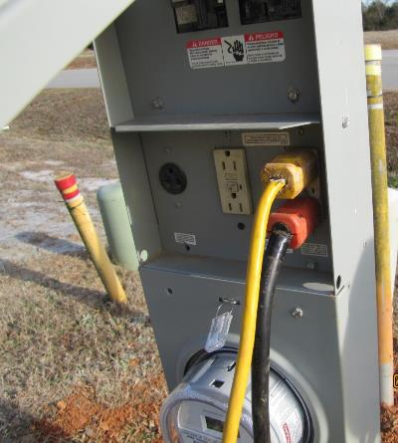
Wiring Design and Protection 1926.404(b)(1)(i)
Employer shall use either ground fault circuit interrupters
Or
An assured equipment grounding conductor program to protect employees.
NCDOL Photo Library

Slide 16
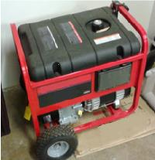
Wiring Design and Protection 1926.404(f)(3)
Portable generators need not be grounded if:
Supplies only equipment mounted on the generator
and/or cord and plug equipment is plugged into
receptacle mounted on the generator.
Noncurrent-carrying metal parts of equipment and
grounding conductor terminals of the receptacle
are bonded to generator frame.
NCDOL Photo Library

Slide 17
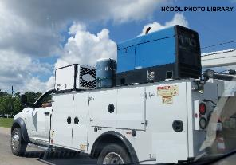
Wiring Design and Protection 1926.404(f)(3)
Vehicle-mounted generators; vehicle frame may serve as system grounding if:
Frame of the generator is bonded to the vehicle
Frame, and
Generator supplies only equipment located on the
vehicle and/or equipment plugged into the generator, and

Slide 18
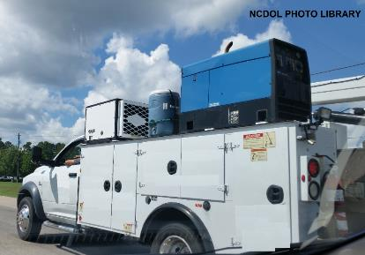
Wiring Design and Protection 1926.404(f)(3)
Noncurrent-carrying metal parts of equipment and grounding conductor terminals of the receptacles are bonded to the generator frame, and
System complies with all other provisions of this section.
Notes:
18

Slide 19
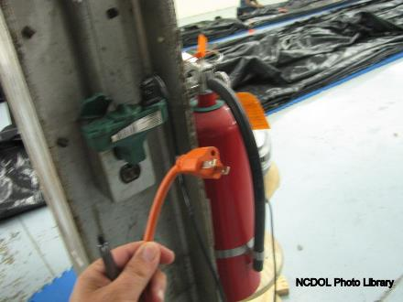
Wiring Design and Protection 1926.404(f)(6)
Path to ground from circuits, equipment, enclosures must be permanent and continuous.

Slide 20
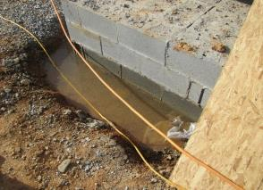
Wiring Design and Protection 1926.404(f)(7)(iv)
Equipment connected by cord and plug.
Noncurrent-carrying metal parts which may become energized must be grounded if:
In a hazardous location
Operated at over 150 V to ground
Except guarded motors and appliances permanently insulated
from ground
Hand held motor-operated tools
Equipment used in wet and/or
conductive locations
Portable hand lamps
NCDOL Photo Library

Slide 21
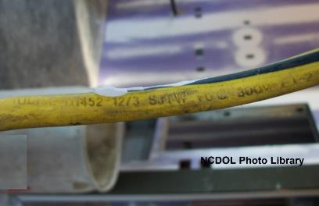
Wiring Design and Protection
1926.405(a)(2)(ii)(I)-(J)
Flexible cords and cables must be protected from damage.
Extension cord sets used with portable electric tools and appliances must be of three-wire type and must be designed for hard or extra-hard usage.

Slide 22
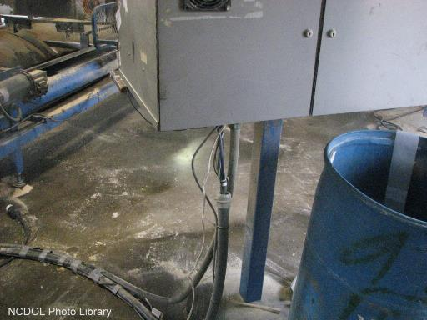
Wiring Design and Protection 1926.405(b)(1)
Conductors entering boxes, cabinets, or fittings must be protected from abrasion.

Slide 23
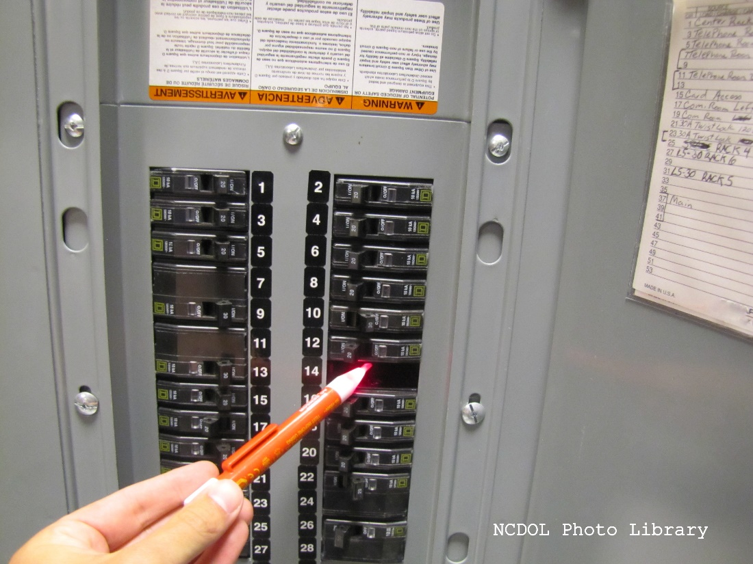
Wiring Design and Protection 1926.405(b)(1)
Unused openings in cabinets, boxes and fittings must be effectively closed.

Slide 24
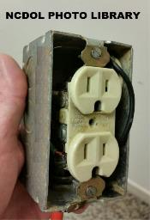
Wiring Design and Protection 1926.405(b)(2)
All pull boxes, junction boxes, and fittings must be provided with a cover.
If metal covers are used, they must be grounded.

Slide 25
Wiring Design and Protection 1926.405(g)(1)(i)
Flexible cords and cables must be suitable for conditions of use and location.
Permitted uses of flexible cords and cables
Pendants and fixture wiring
Portable lamps and appliances
Elevators cables, cranes, and hoists
Stationary equipment to facilitate their frequent interchange
Appliances where the fastening means and mechanical connections are designed to permit removal for maintenance and repair

Slide 26
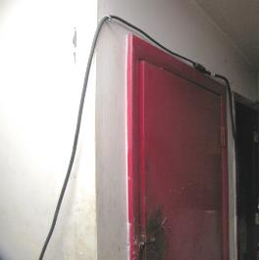
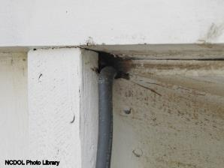
Wiring Design and Protection 1926.405(g)(1)(iii)
Prohibited uses of flexible cords and cables:
As substitute for fixed wiring of structure
Run through holes in walls, ceilings or floors
Run through doors, windows or similar openings
Attached to building surfaces
Concealed behind building walls, ceilings, or floors
NCDOL Photo Library

Slide 27
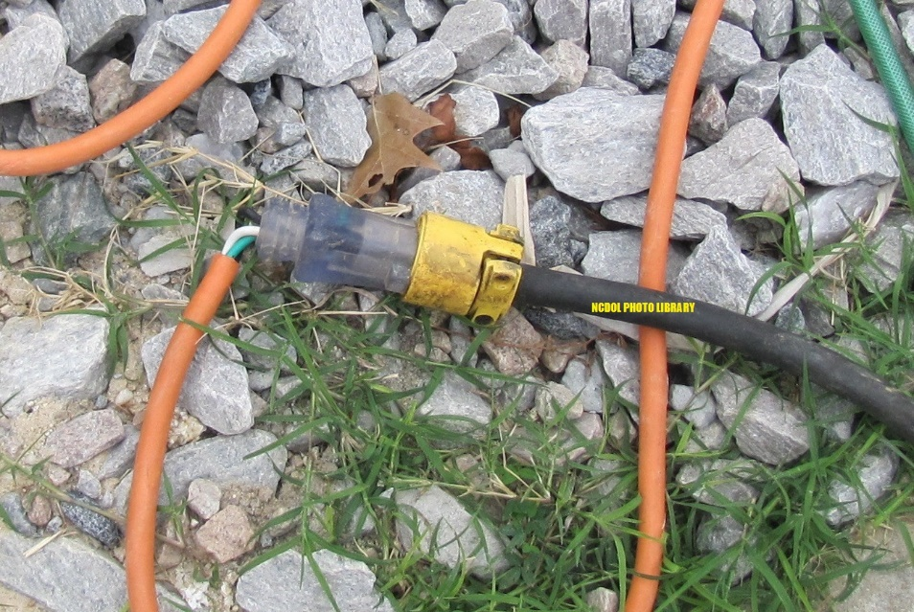
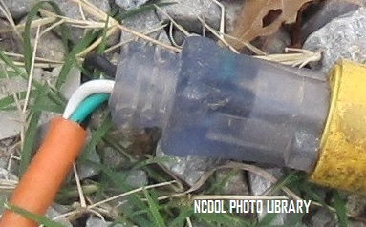
Wiring Design and Protection 1926.405(g)(2)(iv)
Flexible cords shall be connected to devices and fittings so that strain relief is provided.
Will prevent pull from being directly transmitted to joints or terminal screws.

Slide 28
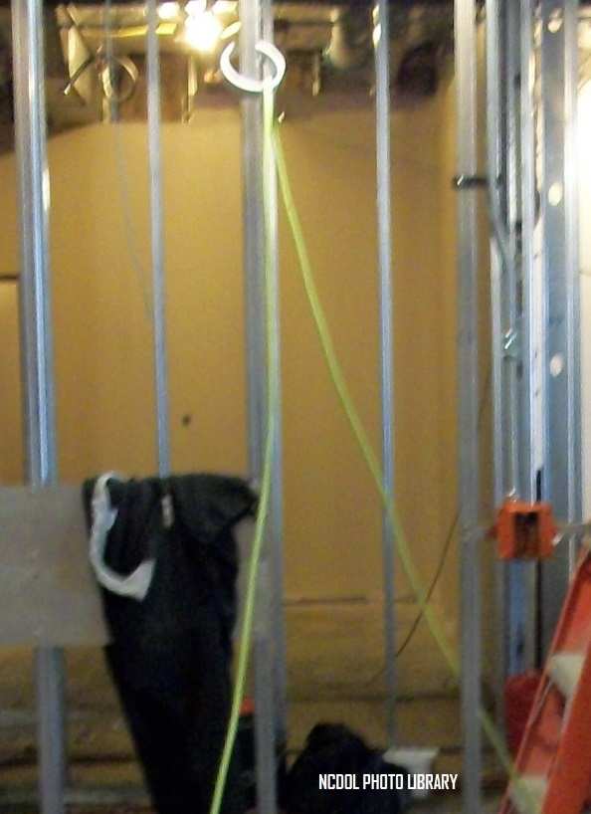
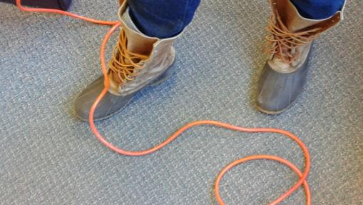
Safety-Related Work Practices 1926.416(b)(2)
Working spaces, walkways, and similar locations shall be kept clear of cords so as not to create a hazard to employees.
NCDOL Photo Library
Notes:
28

Slide 29
Safety-Related Work Practices 1926.416(e)
Extension cords shall not be stapled, hung from nails or suspended by wire.
Worn or frayed electric cords must not be used.

Slide 30
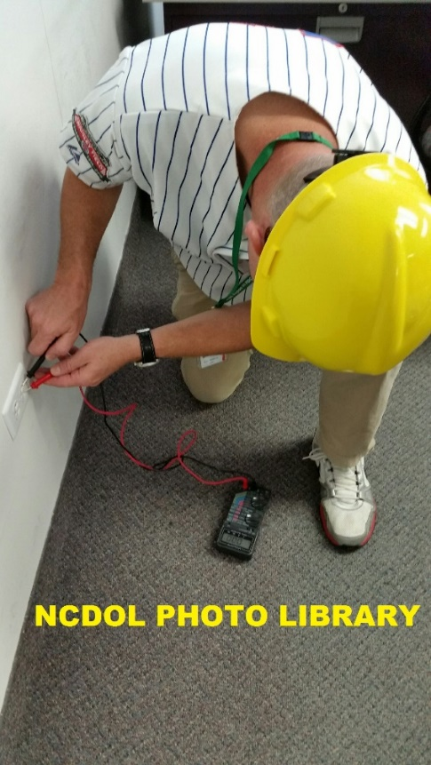
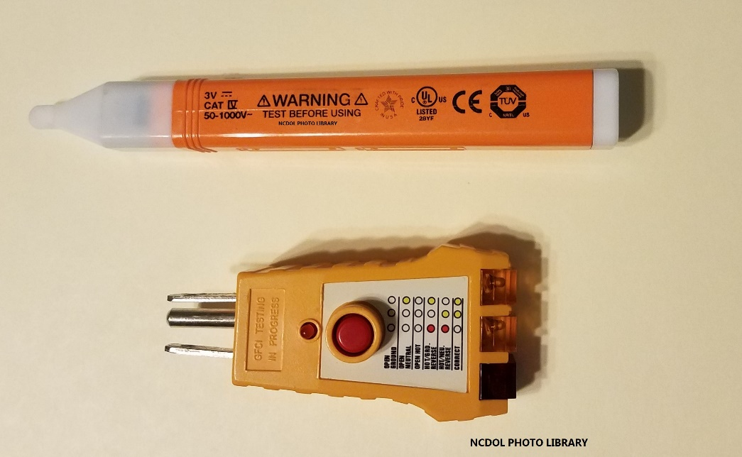
Tools for Identifying Hazards
An electrical receptacle voltage tester
Receptacle Ground Tester with GFCI tester
Analog or Digital Multimeter
Notes:
30

Slide 31
Summary
In this course, we covered:
Common electrical hazards
Standards relating to those hazards
Electrical equipment defects/hazards
Tools/techniques used in identifying hazards

Slide 32
Thank You For Attending!
Final Questions?

